Slide 1

Testing Metrics
Application Testing & Metrics
CIT185753 Kitman Yiu

Slide 2
Introduction
There is also a lot of information about software testing metrics principles, however this information has never been applied in game environments. This presentation will talk about “testing metrics principles” as they are applied in a games environment. Firstly, the benefits of applying testing metrics will be considered. Next, the elements in testing metrics we be analysed to determine the benefits of each of these. Lastly, examples of both good and bad metrics we be presented a discussion of how these can applied to small and large game companies will follow.

Slide 3
Metrics
What is metrics
Good metrics
Bad metrics

Slide 4
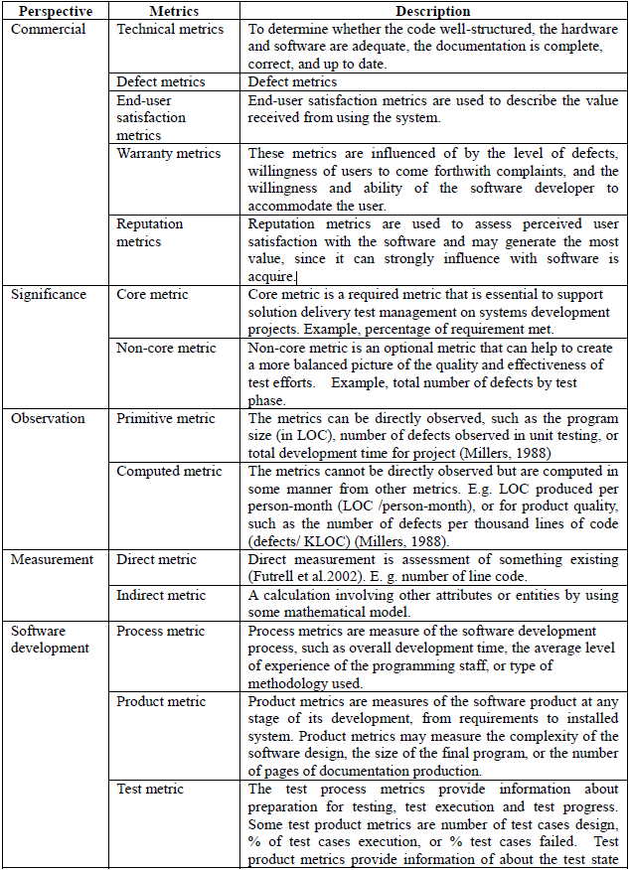
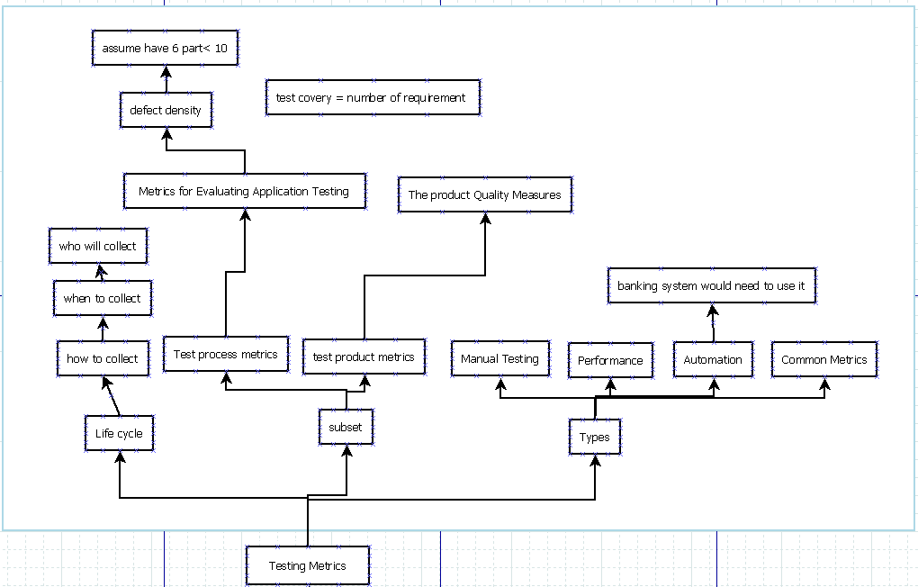
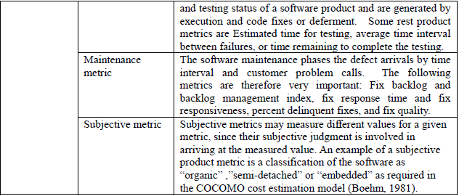
Software Metrics and Software Test Metrics

Slide 5
Testing Metrics Children
Life Cycle
Subset
Types

Slide 6
Metrics Life Cycles
Analysis
Identify Metric(s) to use.
Communiqué
Explain the need of metric to stakeholder and the testing team.
Evaluating
Capture the data.
Reporting
Define Metric(s) identified.
Define parameter(s) for evaluating the metric(s) identified.
Educate testing team about the data points need to be captured for processing the metric.
Verify the data.
Calculating the metric(s) value using the data captured.
Develope the report with effective conclusion.
Take feedback from the stakeholder.
Distribute report to the stakeholder and their representative.

Slide 7
Test Process Metrics
Time
Cost
Quality
==================================================================================================================
Test Coverage = Number of units (KLOC/FP) tested / total size of the system. (LOC represents Lines of Code)
Number of tests per unit size = Number of test cases per KLOC/FP (LOC represents Lines of Code).
Acceptance criteria tested = Acceptance criteria tested / total acceptance criteria
Defects per size = Defects detected / system size
Test cost (in %) = Cost of testing / total cost *100
Cost to locate defect = Cost of testing / the number of defects located
Achieving Budget = Actual cost of testing / Budgeted cost of testing
Defects detected in testing = Defects detected in testing / total system defects
Defects detected in production = Defects detected in production/system size
Quality of Testing = No of defects found during Testing/(No of defects found during testing + No of acceptance defects found after delivery) *100
Effectiveness of testing to business = Loss due to problems / total resources processed by the system.
System complaints = Number of third party complaints / number of transactions processed
Scale of Ten = Assessment of testing by giving rating in scale of 1 to 10
Source Code Analysis = Number of source code statements changed / total number of tests.
Effort Productivity = Test Planning Productivity = No of Test cases designed / Actual Effort for Design and Documentation
Test Execution Productivity = No of Test cycles executed / Actual Effort for testing

Slide 8
Test Product Metrics
Customer satisfaction index This index is surveyed before product delivery and after product delivery (and on-going on a periodic basis, using standard questionnaires).The following are analyzed:
Number of system enhancement requests per year | For a game this can be just one year
Number of maintenance fix requests per year | For a game this can be just one year
User friendliness: call volume to customer service hotline , forums , online chat | In game environments this not only include hotlines , it can also include forums or online chat
User friendliness: training time per new user | This can change to how much player can be able to play the game without asking help
Number of product recalls or fix releases (software vendors)
Delivered defect quantities
They are normalized per function point (or per LOC) at product delivery (first 3 months or first year of operation) or Ongoing (per year of operation) by level of severity, by category or cause, e.g.: requirements defect, design defect, code defect, documentation/on-line help defect, defect introduced by fixes, etc.
Responsiveness (turnaround time) to users
Turnaround time for defect fixes, by level of severity | The level can of severity can be define by the company
Time for minor vs. major enhancements; actual vs. planned elapsed time | This metrics will be used when trying to improve the planning process of the game
Product volatility
Ratio of maintenance fixes (to repair the system & bring it into compliance with specifications), vs. enhancement requests (requests by users to enhance or change functionality) | This maintenance rate should be higher than enhancement requests.
Defect ratios
Defects found after product delivery per function point. | How many bugs have been found in game after released
Defects found after product delivery per LOC
Defect removal efficiency
Number of post-release defects categorized by level of severity | How horrible is the bug , categorized by level of severity, this can found by clients in field operation
Ratio of defects found internally prior to release (via inspections and testing), as a percentage of all defects | How much bugs have been found before release.
All defects include defects found internally plus externally (by customers) in the first year after product delivery | Usually a big game will stop releasing update after one year
Test coverage
The ratio of the number of detected faults to the number of predicted faults.
Cost of defects
Business losses per defect that occurs during operation | This is related to business goal
Business losses per defect that occurs during operation | This is related to business goal
Business interruption costs; costs of work-arounds | This is related to business goal
Lost sales and lost goodwill | This is related to business goal
Litigation costs resulting from defects | This is related to business goal
Annual maintenance cost (per function point) | This include a wide range of cost: For example computer in the company that need to repair
Annual operating cost (per function point) | This can include bills
Measurable damage to your boss's career | This is related to business goal

Slide 9
Test Product Metrics 2
Costs of quality activities
Costs of reviews, inspections and preventive measures | This is related to business goal
Costs of test planning and preparation | This is related to business goal
Costs of test execution, defect tracking, version and change control
Costs of diagnostics, debugging and fixing
Costs of tools and tool support | The tools that you make or the game engine that use to developing the game such as Maya , Visual Studio 2012
Costs of testing & QA education associated with the product | Allow the QA people get updated
Costs of monitoring and oversight by the QA organization | This need to be include if separate from the development and test organizations
Re-work
Re-work effort | hours, as a percentage of the original coding hours
Re-work effort | hours, as a percentage of the original coding hours
Re-worked LOC | source lines of code, as a percentage of the total delivered LOC
Re-worked software components | this is a percentage of the total delivered components
Reliability
Availability | percentage of time a system is available, versus the time the system is needed to be available
· Mean time between failures (MTBF). | How often does it take the game to failure , is will display as a percentage
Man time to repair (MTTR) | How often does it take the developer to repair the game bug , is will display as a percentage
Reliability ratio (MTBF / MTTR) | The ratio of MTBF and MTTR. The MTBF should be higher
Number of production re-runs as a ratio of production runs

Slide 10
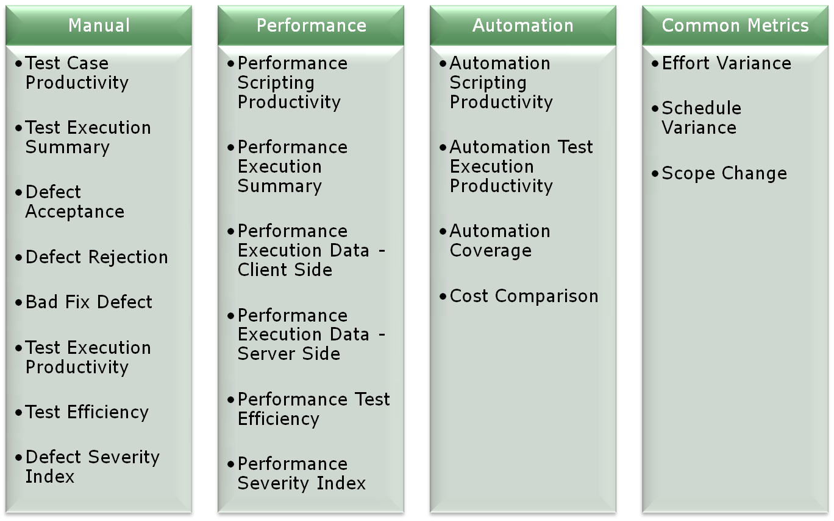
Type of Metrics

Slide 11
Manual Testing
Test Case Productivity | Provides the information for the number of step(s) written per hour.
Test Execution Summary | Provides statical view of execution for the release along with status and reason.
Defect Acceptance | Indicates the stability and reliability of the application.
Defect Rejection | Provides the percentage of invalid defects.
Bad Fix Defect | Indicates the effectiveness of the defect-resolution process
Test Execution Productivity | Provides detail of the test case executed per day.
Test Efficiency | Indicates the testing capability of the tester in identifying the defect.
Defect Severity Index | Provides indications about the quality of the product under test and at the time of release.

Slide 12
Performance Testing
Performance Scripting Productivity | Provides scripting productivity for performance test flow.
Performance Execution Summary | Provides classification with respect to number of test conducted along with status (Pass/Fail), for various types of performance testing.
Performance Execution Data - Client Side | Gives the detail information of Client side data for execution
Performance Execution Data - Server Side | Gives the detail information of Server side data for execution
Performance Test Efficiency | Indicates the quality of the Performance team in meeting the performance requirement(s).
Performance Severity Index | Indicates quality of product under test with respect to performance criteria.

Slide 13
Automatic Testing
Not used

Slide 14
Common Testing
Effort Variance | Indicates effort stability
Schedule Variance | Indicates schedule stability
Scope Change | Indicates requirement stability

Slide 15
Stop Testing
Deadlines, e.g. release deadlines, testing deadlines;
Percentage of test cases passed;
Test budget and rate of spending (your burn rate and the amount of runway it affords you);
Amount of code, functionality, or requirements to be covered;
Minimum accepted bug rate;
Duration of beta or alpha testing periods

Slide 16
Stop Testing 2
1 way
Based on the ratio of passed to failed test cases – there are three methods to interpret this:
Stop when all test cases get passed;
Stop when minimum proportion of test cases need to be passed is reached;
Stop when maximum proportion of test cases allowed to fail is reached.
Exhausting all test cases available for execution during the test run.
2 Way
Mean Time Between Failure (MTBF): obtained by recording the average operational time before the system failure;
Defect density: measured by recording the defects related to size of software;
Coverage metrics: calculated by recording the percentage of instructions executed during tests;
Number and perceived severity of open bugs. The later is usually a subjective evaluation along a scale that ranges from ‘Very Low’ to ‘Very High’.

Slide 17
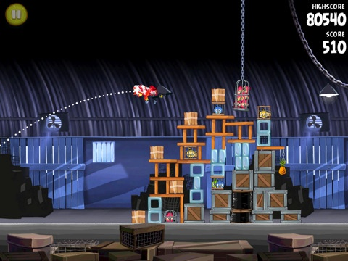
Example 1
Team size
What are you trying?
Time
Money

Slide 18

Example 2
Team size
What are you trying?
Time
Money

